Slide 1
WORK PRESENTATION
BOOK RECOMMENDATION SYSTEM
Date : May 16, 2024
Presented by SHANKS

Slide 2


Presentation Outline
Problem Statement
Data Overview
Tools & Libraries used
Data preprocessing
Exploratory Data Analysis
Recommender Systems
Evaluation Metrics
Future Scope
Conclusion

Slide 3
Problem Statement
In a very general way, recommender systems are algorithms aimed at suggesting relevant items to users (items being movies to watch, text to read, products to buy, or anything else depending on industries).
Recommender systems are really critical in some industries as they can generate a huge amount of income when they are effficient or also be a way to stand out signifficantly from competitors.
The main objective is to create a book recommendation system for users.

Slide 4
Data Overview
Users.csv
User-ID: Unique ID of each user Location: Location of the user Age: Age of the user
Books.csv
ISBN: The International Standard Book Number is a unique numeric Identiﬁer Book-Title: Title of Book corresponding to an ISBN
Book-Author: Author of the book
Year-Of-Publication: Year of Publication of the book Publisher: Publisher of the book

Slide 5
Data Overview
Image-URL-S: Small cover image url to a book Image-URL-M: Medium cover image url to a book Image-URL-L: Large cover image url to a book
Ratings.csv
User-ID: Unique ID of each user
ISBN: The International Standard Book Number is a unique numeric Identiﬁer Book-Rating: Book-Rating are either explicit, expressed on a scale from 1-10 (higher values denoting higher appreciation), or implicit, expressed by 0.

Slide 6





Tools & Libraries Used
Tools
Jupyter
Python
Libraries
Numpy
Pandas
Seaborn
Streamlit

Slide 7

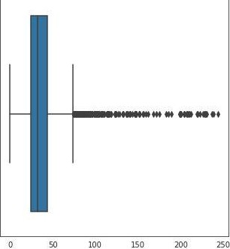
Preprocessing contd.
> Books (books_df)
Replacing null and incorrect values with correct values.
> Users (users_df)
Replacing null and incorrect values.
Box plot of ‘Age’ column□

Slide 8

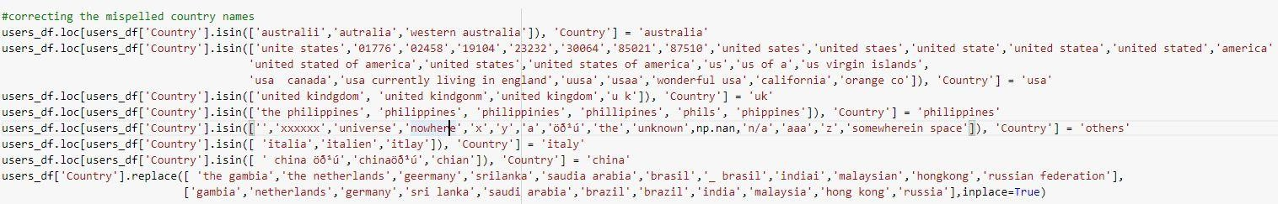
Preprocessing contd.
Users
Correcting misspelled country names that were extracted from ‘Location’ column

Slide 9
Preprocessing contd.
Ratings (ratings_df)
Separating Explicit and implicit ratings

Slide 10
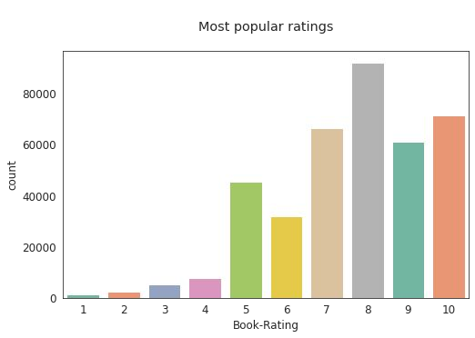
EDA
After merging the datasets
Most of the users have given 5 or above rating
Rating distribution

Slide 11
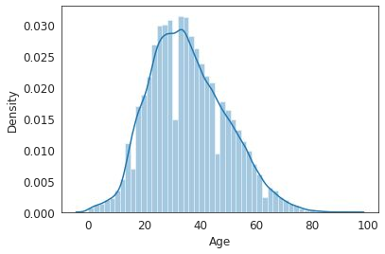
EDA
Majority users are between 25 to 40
Age distribution of users

Slide 12
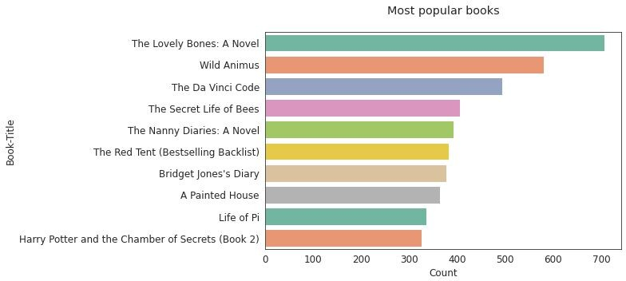
EDA
The Loves Bones: A novel is the most popular book.
Most popular Books

Slide 13
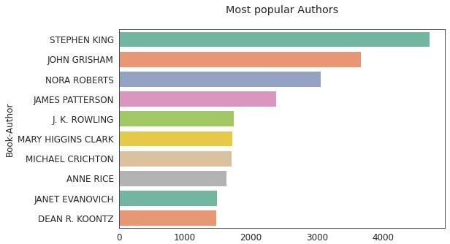
EDA
Stephen King is the most popular author
Most popular Authors

Slide 14
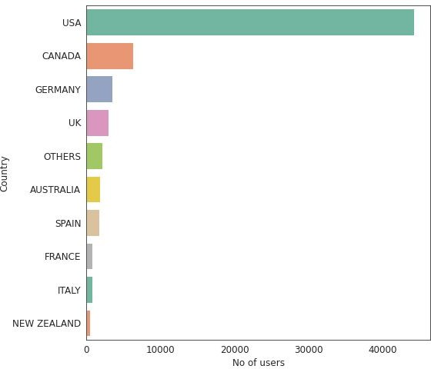
EDA
USA has the highest numbers of users
Countries with highest number of users

Slide 15
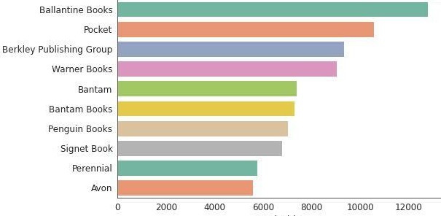
EDA
Publishers with most number of books

Slide 16
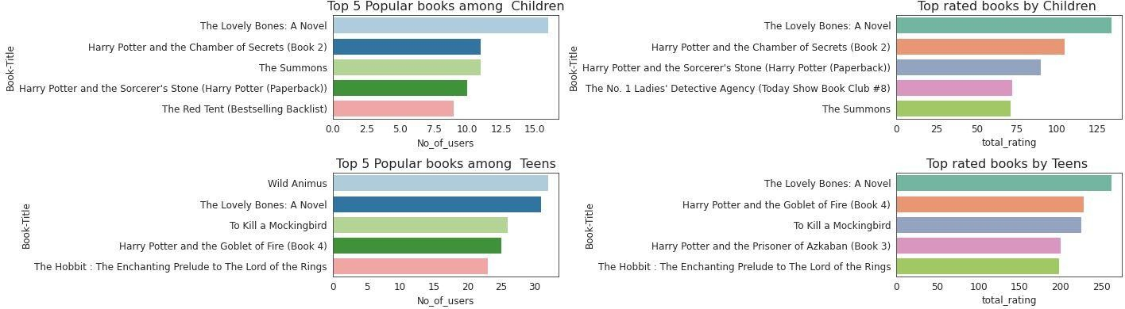
EDA
Most popular Books and Top rated books among Youth and Middle aged adults

Slide 17
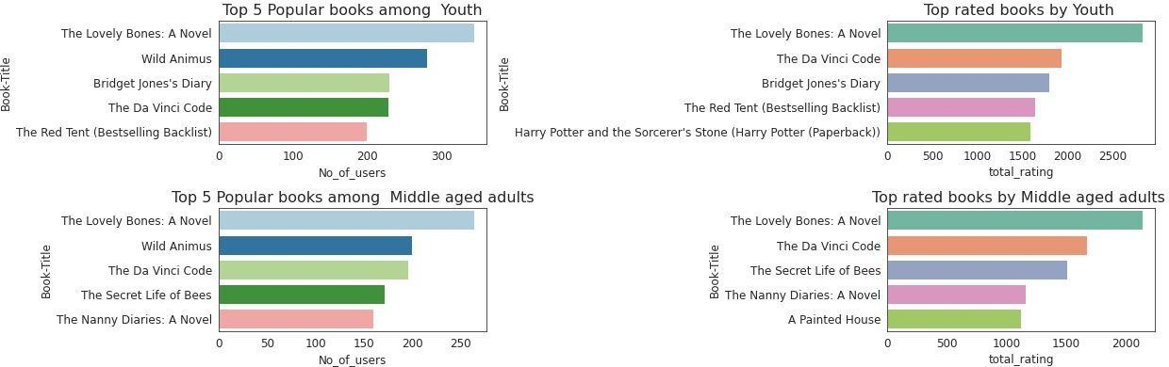
EDA
Most popular Books and Top rated books among Youth and Middle aged adults

Slide 18
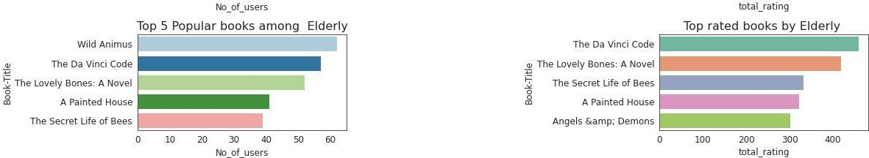
EDA
Most popular Books and Top rated books among the elderly

Slide 19
Conclusions based on EDA
Most of the users have given a rating of 5 or above to the books.
The majority of readers are between the ages of 25 and 40.
Stephen King is the most popular author.
The majority of readers who have given the books ratings are from United States (US).
Ballantine Books has published most number of books.
The Lovely Bones: A Novel is the most popular book.
Lovely Bones :A Novel is also highly rated by users of all age groups.

Slide 20
Recommender Systems
Following recommender systems were chosen:
Popularity Based Recommender Systems
Country wise
Author wise
Weighted average rating
Collaborative Filtering based Recommender Systems
Memory Based (Item- Item): KNN based recommender system
Model based : SVD based recommender system

Slide 21
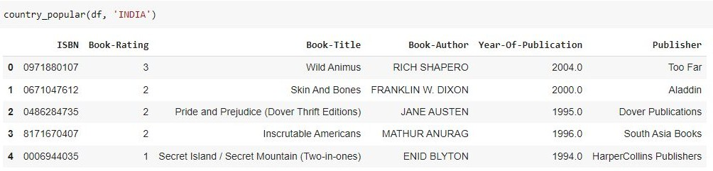










Recommender Systems
Popularity Based
Country wise
Input : INDIA

Slide 22
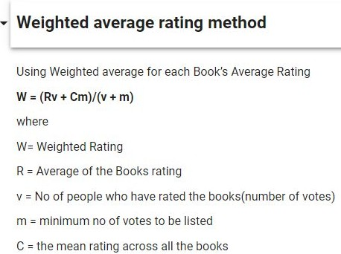

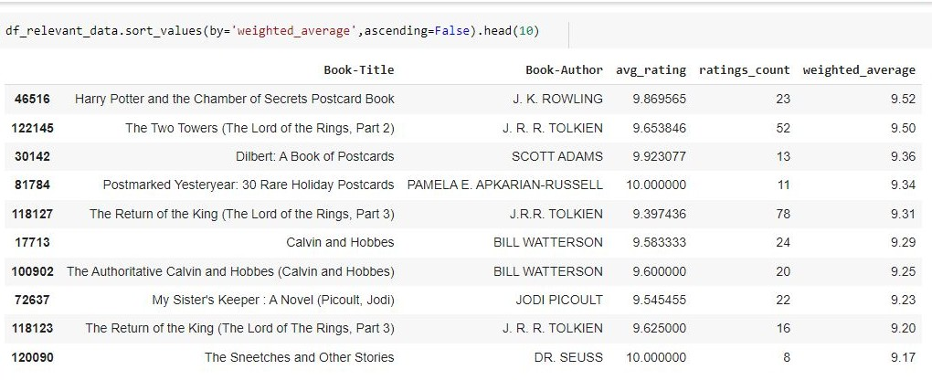
Recommender Systems
Popularity Based
Weighted average rating approach

Slide 23

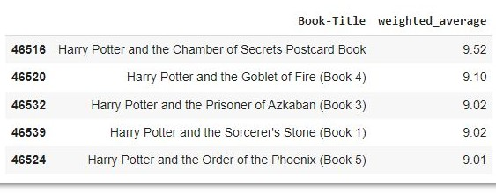









Recommender Systems
Popularity Based
Author wise

Slide 24

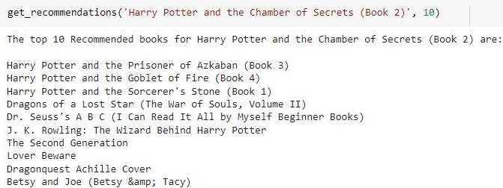
Recommender Systems
Memory Based CF - KNN (Euclidean distance based)

Slide 25

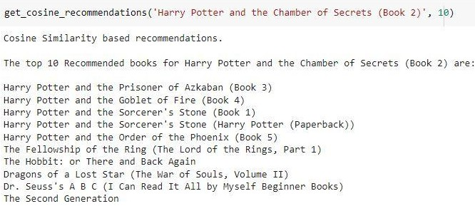
Recommender Systems
Memory Based CF - KNN (with cosine metric)

Slide 26

Recommender Systems
Popular book recommendations

Slide 27

Recommender Systems
Country based recommendation

Slide 28
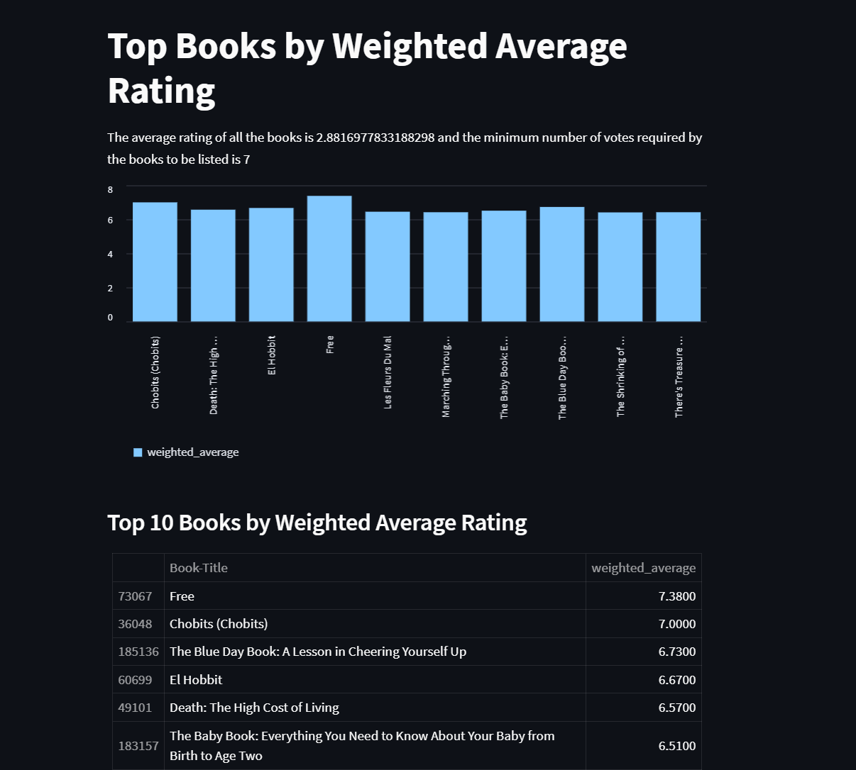
Recommender Systems
Weighted average rating

Slide 29
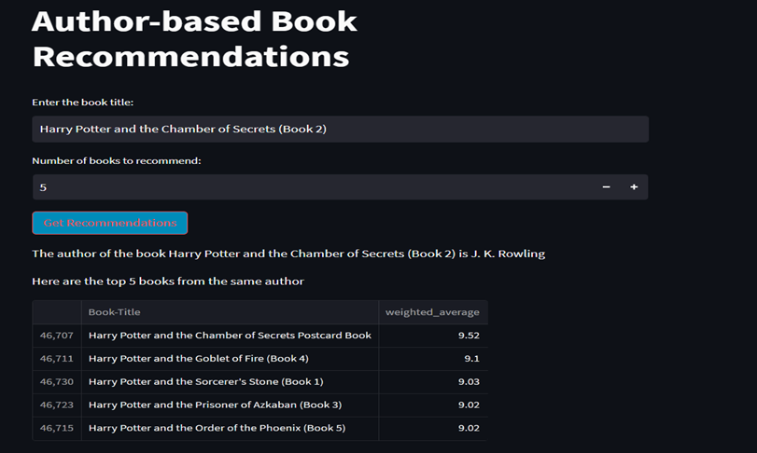
Recommender Systems
Author based book recommendations

Slide 30
ADVANTAGES OF BOOK RECOMMENDATION SYSTEM
Discovery of new books of different genre.
Enhance user engagement.
Improve overall educational knowledge.
Simple to use and learn.

Slide 31
FUTURE SCOPE
Enhanced Personalization: Improve the system's ability to understand user preferences by incorporating more sophisticated AI algorithms such as collaborative filtering, content-based filtering, and hybrid approaches.
Scalability and Performance: Optimize the system architecture and algorithms to handle large-scale data and increasing user traffic efficiently. This could involve implementing distributed computing techniques and utilizing cloud-based infrastructure.
Mobile and Web Application Development: Develop mobile and web applications

Slide 32
Conclusion
The initial step, of our project was Data preprocessing of the three datasets-books_df, users_df and ratings_df, wherein we removed duplicates and imputed the missing values & invalid entries with appropriate values and corrected spellings .
Then, we used Popularity-based approach, Collaborative ffiltering approach to built different types of recommendation models.
I n the case of Memory-based approach, the Cosine similarity-based KNN performs better at recommending books that are similar than the Euclidean distance-based KNN.
We evaluated the performance of Singular Value Decomposition based recommender and obtained a Global Recall@5 of 3 0% and Recall@10 of 41%.41%

Slide 33


